Slide 1

Business Communication
Demonstrating Professional Communication in a Corporate Context

Slide 2
Overview of Business Communication
Business communication refers to the process of sharing information within and outside an organization.
Effective communication builds professional relationships and ensures organizational goals are achieved.
In ICT environments, clarity, tone, and digital etiquette are essential.

Slide 3
Key Learning Outcomes
The importance of tone and structure in professional writing.
Email etiquette and clarity in workplace communication.
How communication supports collaboration and productivity.

Slide 4
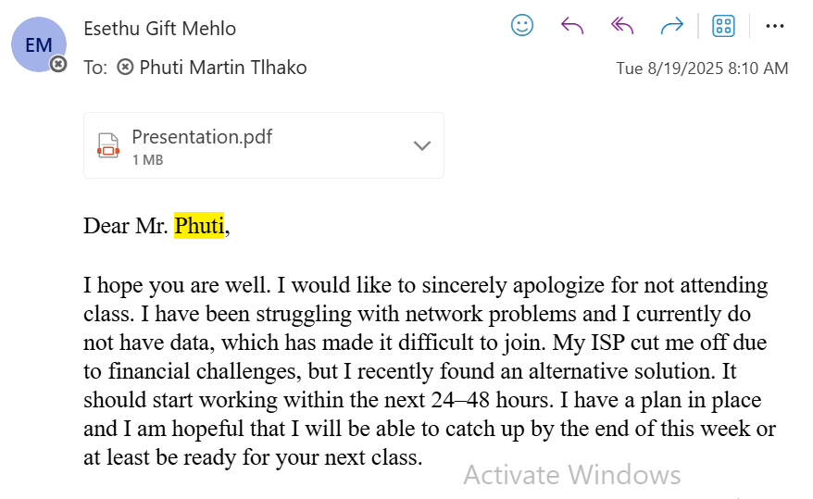
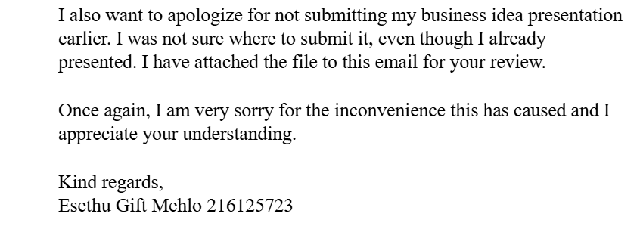
Email to my project mentor explaining why I could not meet his deadline and asking ofr an extension

Slide 5
Reflection
Situation: During the Work Readiness Training, I needed to improve my formal communication.
Task: My goal was to develop effective writing skills for corporate settings even though I was in the wrong.
Action: I practiced drafting professional emails and refined my tone and structure.
Result: I can now communicate professionally and with confidence in any business context.

